Slide 1
WEEK 3- GASTRULATION
Dr. Mbira

Slide 2
During the third week, the bilaminar germ disc will be converted to a 3-layered structure in a process called gastrulation. The 3 germ layers will be the precursors of all the subsequent embryonic tissues.
The 3 germ layers are:
Ectoderm
Mesoderm
Endoderm
Also in the 3rd week:
The embryo will get axial orientation, i.e what is cranial or caudal, what is anterior or posterior e.t.c.
The beginning of development of body form i.e morphogenesis.
The embryo in this week is also referred to as a gastrula.

Slide 3
Gastrulation begins with the appearance of a shallow groove called a primitive streak in the midline of the epiblast layer on the side facing the amniotic cavity. This groove will have an elevation of cells on each side of it resembling a small ridge.
At the cephalic end this primitive streak will terminate in a small shallow pit called the primitive pit surrounded by an elevation of cells to form what is called the primitive node.
Epiblast cells then migrate towards the primitive streak and on reaching it they detach from the epiblast, slip beneath the streak to occupy a newly created space between epiblast and hypoblast. This process is called invagination.
Some of the migrating cells also displace the hypoblast so that there are now 2 new layers, the innermost will be the endoderm, the middle one the mesoderm and the remaining cells in the epiblast will become the ectoderm.

Slide 4
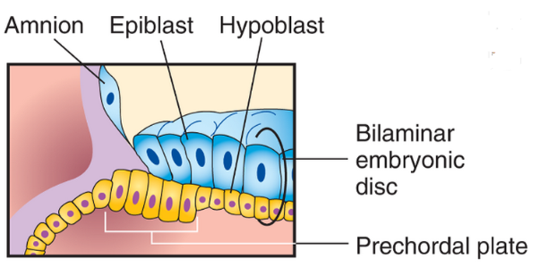
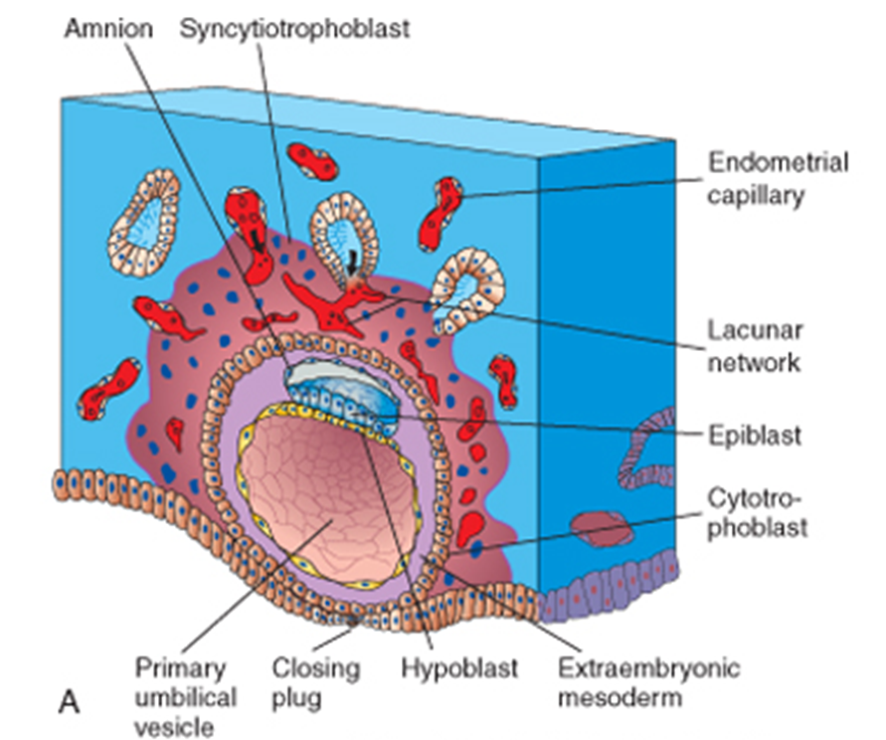

Slide 5
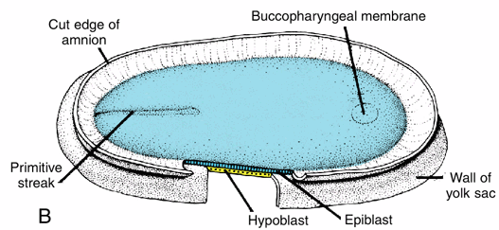
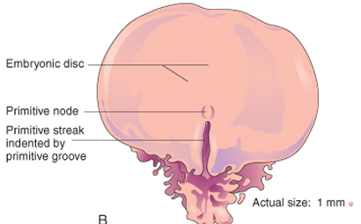
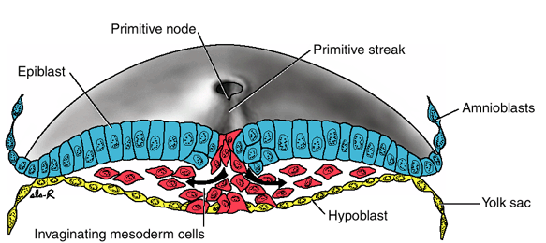

Slide 6
The invaginating cells will migrate laterally until they reach the extraembryonic mesoderm as well as cranially.
Cranially, the migrating cells will skirt around the prechordal plate.
At the cranial end of the gastrula, the ectoderm and endoderm cells will be tightly packed together without intervening mesoderm to form the buccopharyngeal membrane.
The prechordal plate is important in the development of the brain in the future will become the buccopharyngeal membrane which will in turn become the site of the opening of the oral cavity.

Slide 7
Cells invaginating in the primitive pit migrate cranially until they reach the prechordal plate. These are the pre-notochordal cells that will eventually form the notochord.
Initially the prenotochordal cells are joined together with cells of the hypoblast layer form a notochordal plate.
The prenotochordal plate cells will eventually detach from the hypoblast which at this time is being replaced/displaced by cells which will form endoderm. When the prenotochordal cells detach, they form the definitive notochord.
The notochord elongates as the embryo elongates and will extend from the region of the prechordal plate/buccopharyngeal membrane to the primitive pit at the primitive node of the primitive streak.

Slide 8
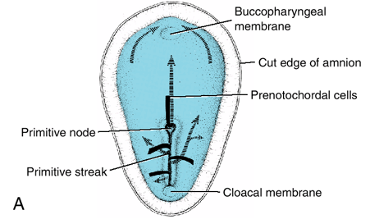
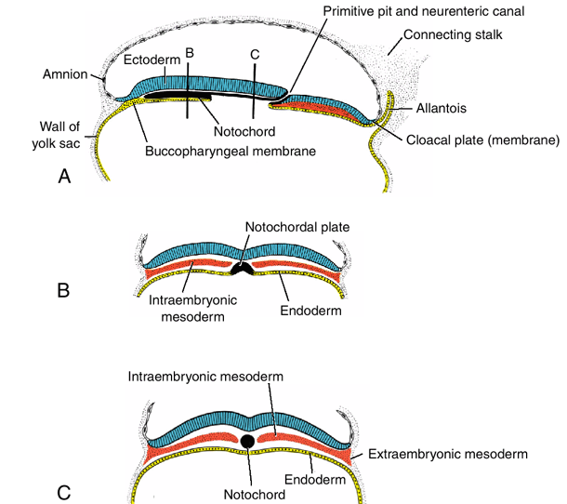

Slide 9
While the buccopharyngeal membrane is forming in the cranial end of the embryo/gastrula, there is a similar structure at the caudal end formed also by tightly compacted ectoderm and endoderm without intervening mesoderm and it is called the cloacal membrane.
The cloacal membrane is the future site of the anus.
When the cloacal membrane appears, the yolk sac at this end forms a small projection/diverticulum into the connecting stalk called the allantois/allantoenteric diverticulum.
The allantois in humans is rudimentary and serves no function.
This is around day 16 of development.

Slide 10
The embryonic disc in the beginning of the 3rd week (or at the end of the 2nd week) is round and flattened, but in the course of gastrulation it develops more on the cranial region and thus it elongates and widens cranially while the caudal region changes only slightly.
Most of the growth at this stage will occur from the primitive node/pit cranially as cells migrate from this region cranially and laterally.
The disc will therefore elongate and be broad cranially while remaining narrow caudally.
Also, cells in the broader and longer cranial region begin to differentiate in the middle of the 3rd week while it will take up to the 4th week for gastrulation to complete in the caudal region and for cells to begin differentiating.
The primitive streak will continue supplying cells that migrate and gastrulate until the end of the 4th week when it will disappear.

Slide 11
Various genes expressed by the cells at the cranial end of the embryonic disc, the primitive node, the primitive streak itself help to orient the embryo to determine what is cranial or caudal, what is left or right as well as what is anterior or posterior.

Slide 12
The notochord :
Defines the longitudinal axis of the embryo and gives it some rigidity.
Induces formation of axial musculoskeletal structures and the central nervous system(CNS).
Contributes to the intervertebral discs in future as the nucleus pulposus.
It induces/signals the overlying ectoderm to form the neural plate which will eventually form the CNS.

Slide 13
Neurulation
Neurulation is the process by which the ectoderm overlying the notochord forms the neural tube.
It begins in the 3rd week and completes at the end of the 4th week.
As the notochord develops, it induces the overlying cells of ectoderm to thicken and form a plate, the neural plate.
The neural plate will initially correspond in length and breadth to the underlying notochord, but will eventually surpass it and also be broader.
At around day 18, the neural plate begins to invaginate to form a groove, the neural groove with neural folds on each side.
The neural folds are more prominent in the cranial region where they are the precursors of the brain.
The neural folds begin to come together to form the neural tube at the end of the 3rd week.

Slide 14
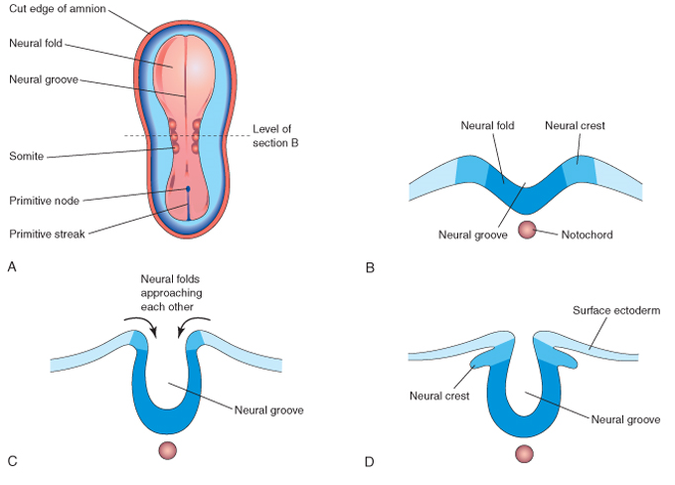

Slide 15
Somites
Towards the end of the 3rd week, the mesoderm will be in 3 zones: paraxial mesoderm, intermediate mesoderm and lateral mesoderm.
Lateral mesoderm will be continuous with the extraembryonic mesoderm covering the amnion and the yolk sac.
The paraxial mesoderm will condense on each side of the developing neural tube, differentiate and begin to form cuboidal blocks of mesoderm called somites. These form in a cranio-caudal sequence from day 20-30 initially 38 pairs but finally by th 5th week reaching 44.
They give rise to the axial skeleton, its musculature as well as the skin and dermis overylying it.

Slide 16
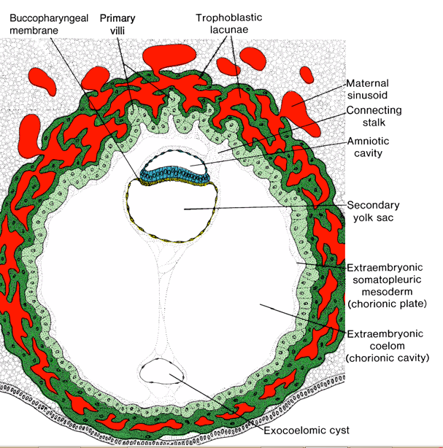
Cardiovascular system
Nutrients by the end of the 2nd week diffuse from maternal blood in the trophoblastic lacunae through the extraembryonic coelom and the yolk sac as well as the extraembryonic mesoderm to the embryo.

Slide 17
In the course of the 3rd week, the circulatory system begins to develop.
Mesodermal cells migrate to the area cranial to the prechordal plate/buccopharyngeal membrane called the cardiogenic area where they will start to aggregate together and differentiate to begin forming the primordial heart.
Also some mesodermal cells will differentiate to form blood vessels initially in the extraembryonic mesoderm of the yolk sac, connecting stalk and chorion and (2 days) later in the embryo.
By the end of the 3rd week, there is a complete circuit connecting the primordial heart, the vessels in the embryo, yolk sac, connecting stalk and chorion.

Slide 18
Trophoblast
At the beginning of the 3rd week, the primary villi of the trophoblast are made up of syncytiotrophoblast in which is a protrusion of cytotrophoblast like a core.
In the course of week 3, extraembryonic mesoderm also infiltrates each villus to form a mesoderm core and this is now known as the secondary villus.
By the end of the 3rd week, the mesoderm in the secondary villus forms blood vessels with blood cells becoming the tertiary or definitive placental villus.
The vessels in the tertiary villi will connect with similar ones developing in the mesoderm of the connecting stalk and which in turn will connect with similarly developing vessels in the embryo.

Slide 19
At the same time, cytotrophoblast cells in the villi will penetrate the overlying syncytiotrophoblast to make contact with the endometrium.
The cytotrophoblast extensions past the syncytial layer will connect with other similar extensions to form an external shell derived from syncytiotrophoblast that will not only anchor to the endometrium but also surround the entire embryo.
The part of the endometrium where the outer cytrotrophoblast shell will attach (firmly) is called the decidua basalis.
Thus by the end of the 3rd week, the embryo and by extension via the connecting stalk is attached firmly to the endometrium with vessels between mother and developing fetus ready to exchange material across the fetal-maternal barrier made up of the endothelium/cell membrane of the villi capillaries, embryonic connective tissue, syncytio and cytotrophoblast.

Slide 20
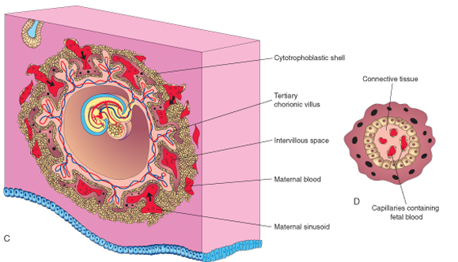
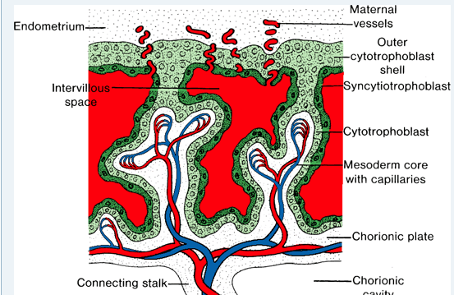

Slide 21
*sacrococcygeal teratomas
*Chordomas
*Disorders of gastrulation
*Hydatidiform mole
*The tissues that arise from the 3 germ layers:
e.g ectoderm- skin, CNS
mesoderm – muscles, CVS, musculoskeletal system
endoderm- epithelial lining and glands as well as associated organs of GIT and RESP.

